Slide 1
Pricing Optimization
Event Company

Slide 2
Scope
Problem statement
An events company runs tens of events a year with 200-2000 attendees at each event
Event and attendee characteristics vary across industries and event types
What we are trying to learn: Are the event prices that are being charged from attendees revenue maximizing?

Slide 3
Data Sets
Problem statement
Two Data sets:
Individual orders - ticket type, price, time, etc.
Event performance - # of Attendees, Revenue, etc.
Extensive data clean-up was required
Removal of erroneous symbols
Unique “id” variables created to avoid sensitive data
New variables for attendee types and seniority among others

Slide 4
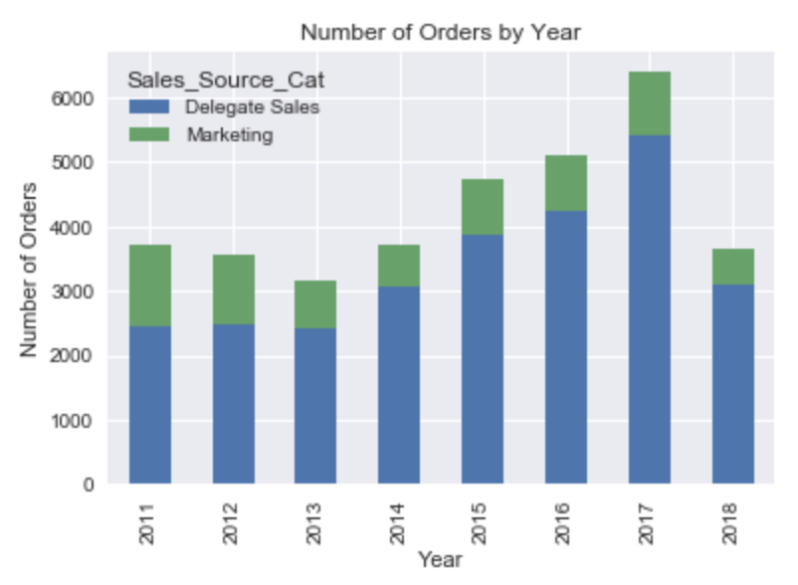
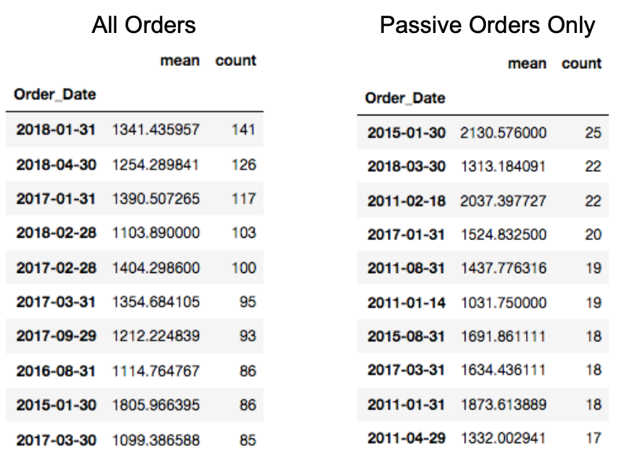
Overall revenue growth… with interesting patterns
Exploratory data analysis
Overall revenue from ticket sales has been growing, while the majority of the tickets get sold through an outbound phone sales team.
The days with the most registrations often fall of the last day of the month. This is particularly evident when looking at all ticket sales, which include the sales team.
Discounting deadlines or commission incentives the major contributor? Potential test: Changing discount deadlines from monthly to twice a month.

Slide 5
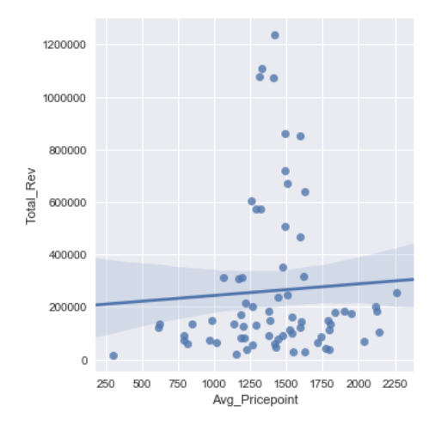
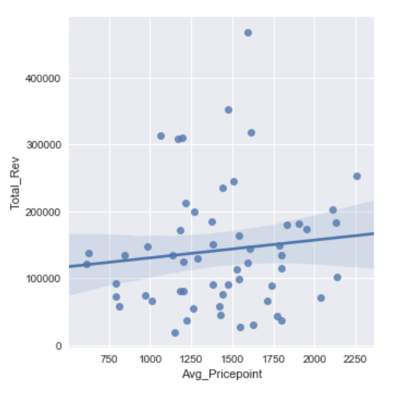
Pricing and Revenue
Exploratory data analysis
Some industries showed a positive correlation between higher prices paid and greater event revenue. Logistics and CX events had clear positive correlations. Others required deeper analysis, for example, retail:
Initially, looking at all of the retail events, on average, a $100 increase in the average price point was associated with a $4420 increase in total revenue from ticket sales. There are obvious outliners in the picture though, which are events with very high revenue or those driven mostly by comps (low price points)
Removing these give a more moderate effect of a $100 increase in the average price point, which is associated with a $2650 increase in total revenue from ticket sales. Consideration: What is the operational cost of such an average price increase?

Slide 6
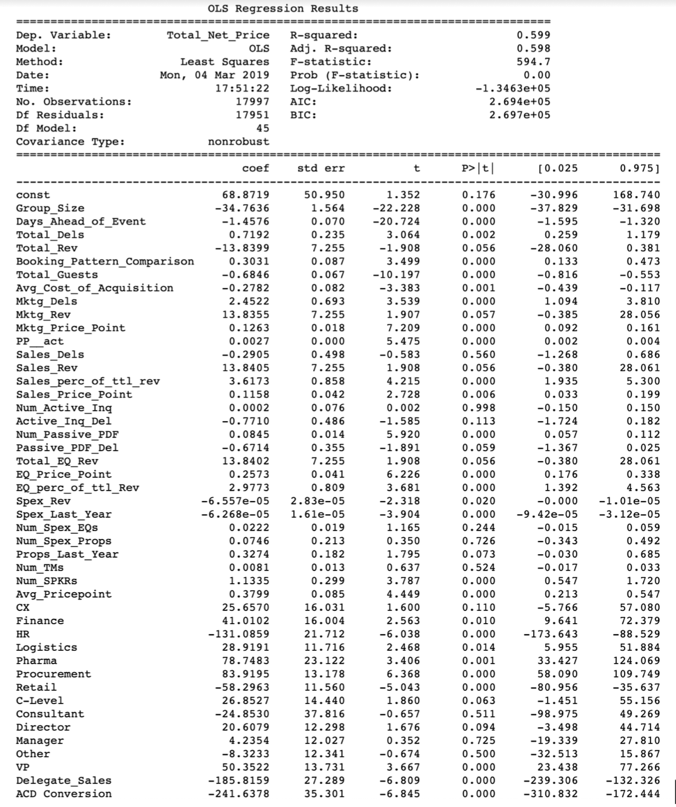
LINEAR REGRESSION - Baseline model
MACHINE LEARNING
The root mean square error of this initial model was $429, which is nearly 25% of the average, or baseline, conference passes.

Slide 7
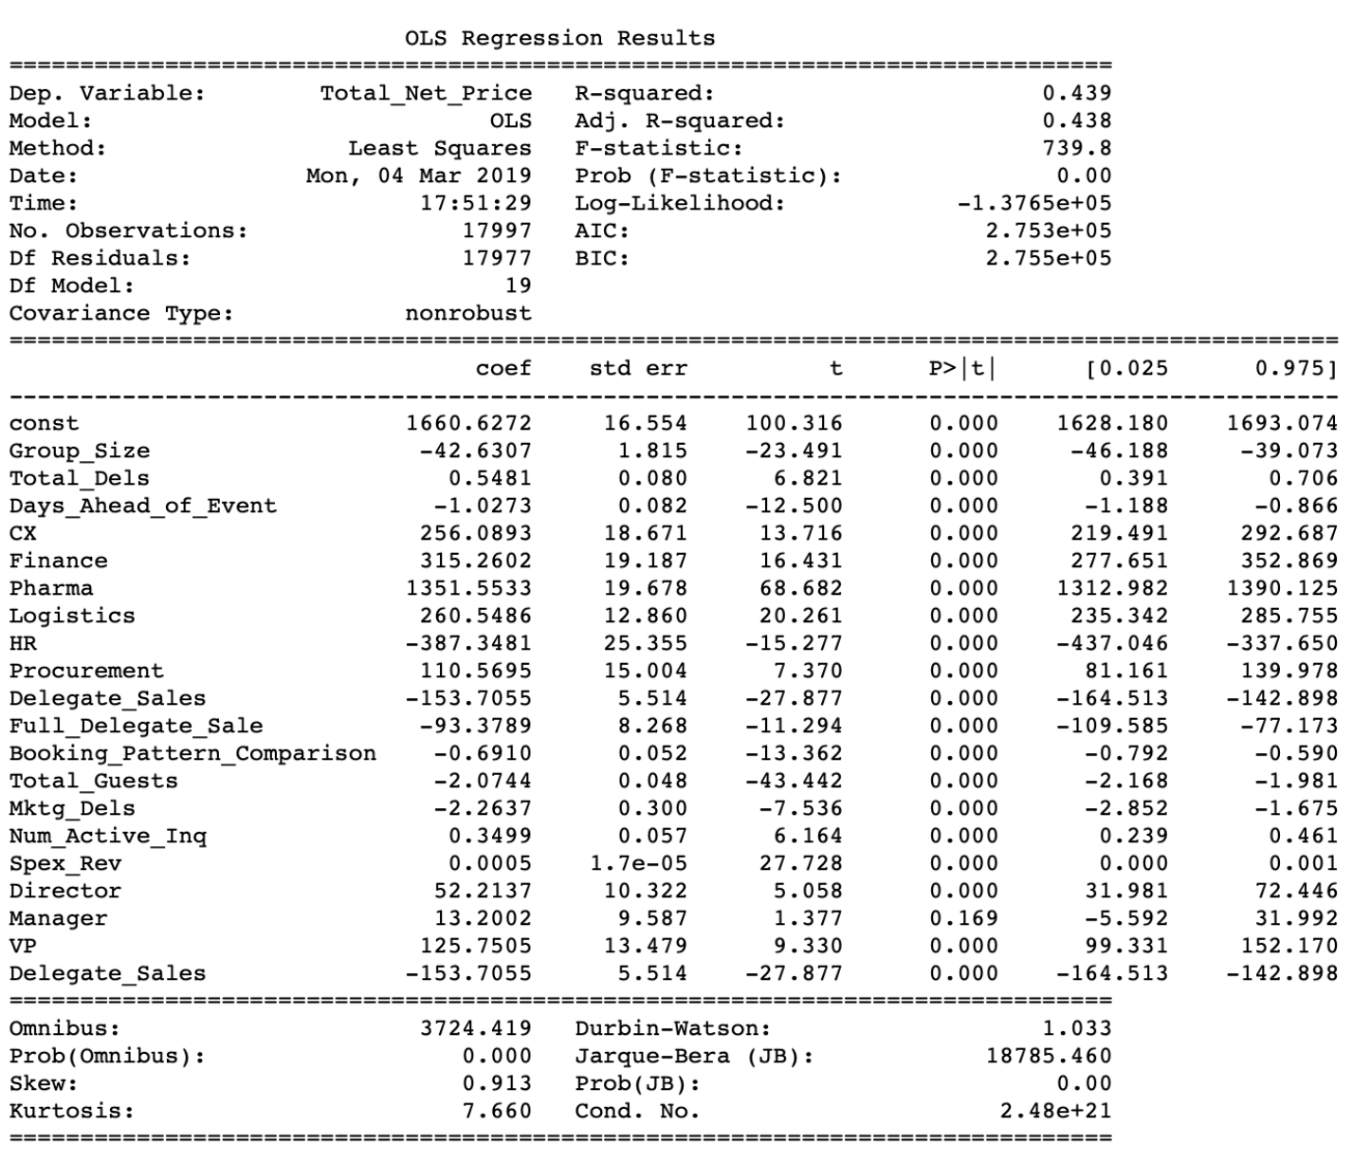
LINEAR REGRESSION - SELECTED FEATURES
MACHINE LEARNING
Before looking at collinearity, a model looking only at features that are more likely to have an effect on the price was reviewed.
While the constant price was much closer to the average price, we could see that the R2 has decreased and the RMSE increased to $507, which means that our error took us even further from explaining the price paid. The removed features had important explanatory factors.

Slide 8
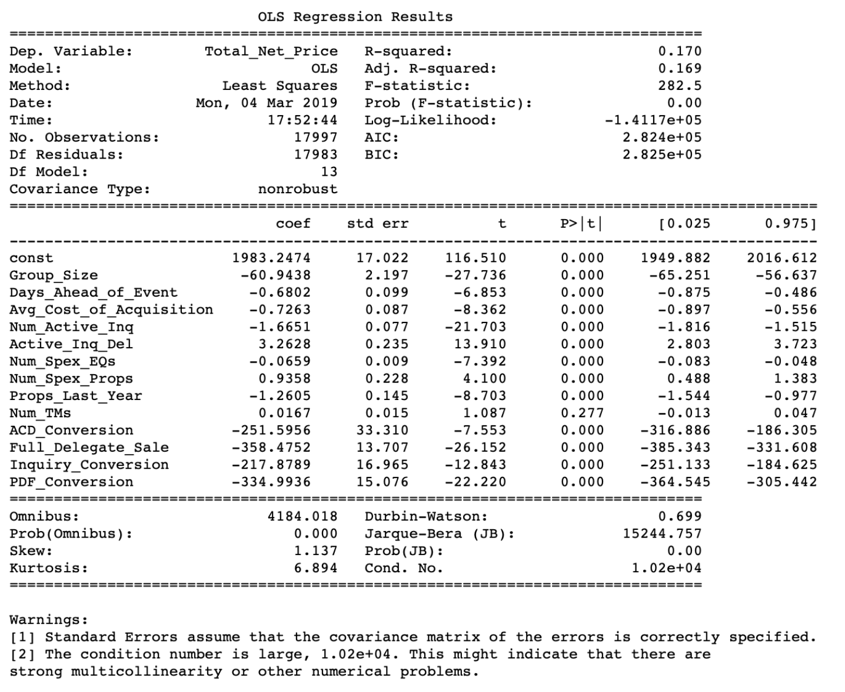
LINEAR REGRESSION - Addressing collinearity
MACHINE LEARNING
After removing dummy variables and iteratively removing collinear features by looking at VIFs, a much shortened model was compiled.
As can be seen, the our fit of the model decreased by looking at the R-Squared and the RMSE increased even more to over $600.
Subsequently, attempts to find a better learning models beyond linear ones were taken.

Slide 9
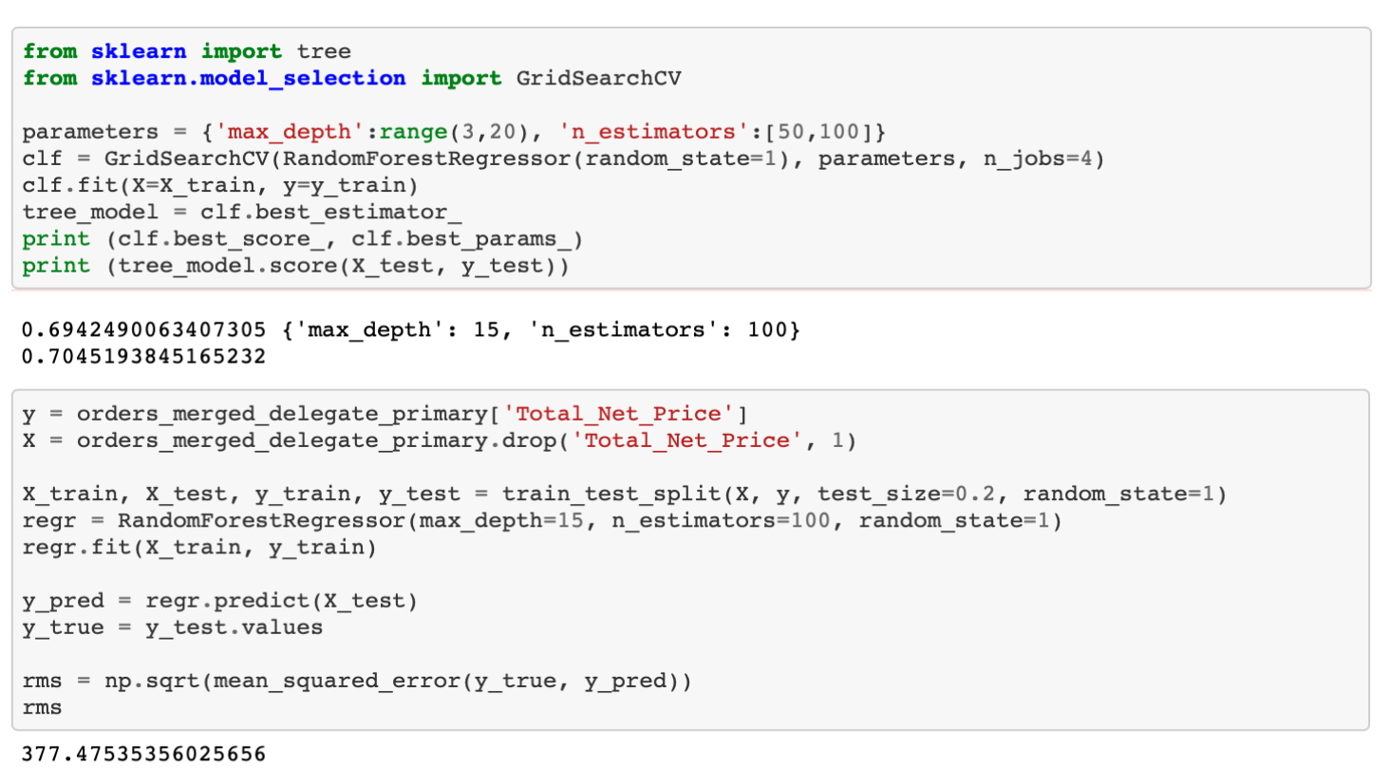
Random FoRests - a stronger model
MACHINE LEARNING
An out-of-the-box RF model gave us a very similar model fit as the linear regression with a model fit score of .53 - very similar to the R2 of the linear model.
Using GridSearchCV, however, allowed us to get the depth and number of trees to be able to get an improved model fit and reach a score of .70.
Using this larger tree depth and increased number of estimators allowed us to lower the RMSE to $377 - a substantial improvement over the baseline regression model.

Slide 10
How large of an impact?
Business Case
Calculating RMSE from price paid vs. average price for that event resulted in RMSE of $542 on average.
Our RMSE of $377 is an improvement of 30% on the difference between the final price paid and the average price.
This 30% constitutes the opportunity in understanding what the pricing power in a sales instance is and subsequently the revenue potential of that sale.

Slide 11
A few business Recommendations
Business Case
Tickets sold offline show strong discounting - incentivizing online registrations can result in an increased price of $150 per ticket on average
Significant variation across verticals - looking closely at the ticket price to total revenue correlations can show where there is pricing power
Utilizing the Random Forests model could help optimize pricing and evaluate its effects on demand
Changing discount and commission deadlines to be more frequent is more likely to result in more “strong sales days” and increased ticket sales

Slide 12
Future Scope of Work
Business Case
Considering Inquiries as part of the larger data set - this would give a fuller demand picture per event
Monitoring the prices that are coming through by the utilization of the model. Are they improving the average prices and overall revenue?
More quantitative data to be included: Google Analytics (visits, page conversions, etc…) and company analytics (size, employees, resources, etc…)
Running similar models on sponsorship investments

